Slide 1
Welcome to Week-8
Advanced Programming in Python
By Engr. Imran Khan
Instructor

Slide 2
Today and Tomorrow
Use map(), lambada
Numpylinespace
Numpy.eye, Numpy.diag, Numpy.repeat
Use vstack,hstack
Numpy add, divide, multiply and use dot() astype,use sum(),max()
min(),mean() Numpy .random.randint()
Enumerate() Inner_join()
scale()
pivot

Slide 3
Map Function
Built-in function
it allows you to process and transform all the items in an iteratable without any loop
Reduce code length
Code can be easily readable
Notes:
We can also get out of a while whenever we want with break.
Usually used with an if statement
Redo last example
Can also be used in for loops

Slide 4
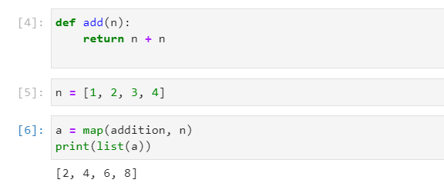
Map Function
You can add more then one argument
Map function return map class
Notes:
We can also get out of a while whenever we want with break.
Usually used with an if statement
Redo last example
Can also be used in for loops

Slide 5
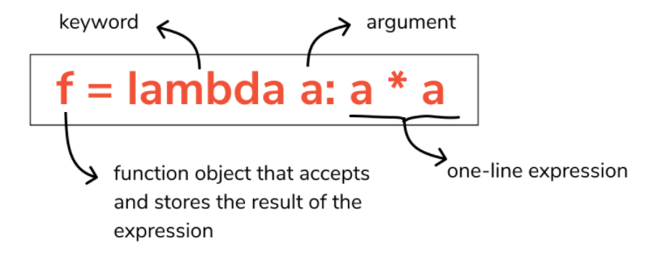
Lambda Function
Small Anonymous function or function having no name
Can take any number of argument
It will have just one expression
Notes:
We can also get out of a while whenever we want with break.
Usually used with an if statement
Redo last example
Can also be used in for loops

Slide 6
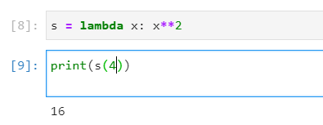
Lambda Function
You can pass more than one argument
It’s is mostly uses for one line expressions
Notes:
We can also get out of a while whenever we want with break.
Usually used with an if statement
Redo last example
Can also be used in for loops

Slide 7
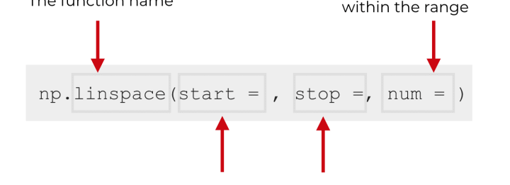
Numpy LineSpace function
Similar to arrange function in Numpy
Generates numbers b/w two values
Notes:
We can also get out of a while whenever we want with break.
Usually used with an if statement
Redo last example
Can also be used in for loops

Slide 8
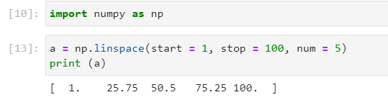
Numpy LineSpace function
Numbers will random generated
Notes:
We can also get out of a while whenever we want with break.
Usually used with an if statement
Redo last example
Can also be used in for loops

Slide 9
Numpy eye, diag, repeat
Let’s go to Numpy Documentation
Notes:
We can also get out of a while whenever we want with break.
Usually used with an if statement
Redo last example
Can also be used in for loops

Slide 10
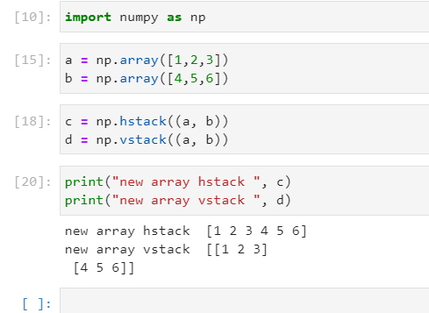
Numpy hStack() vs vStack()
Numpy Built in functions
Use to Stack sequences of input arrays
H is for Horizontal or and V is for Vertical
Notes:
We can also get out of a while whenever we want with break.
Usually used with an if statement
Redo last example
Can also be used in for loops

Slide 11
Numpy built in functions
Np.add() used for adding two arrays
Np.divide() used for dividing two arrays
Np.multiply() used for multiplication
Np.sum() return summation
Np.max() return maximum value
Np.min() return minimum value
Return mean() of array
Dot product return dot product of two matrix
Notes:
We can also get out of a while whenever we want with break.
Usually used with an if statement
Redo last example
Can also be used in for loops

Slide 12
join()
Pandas built in fuction
It returns only those values depends on the join
Left_join(), Inner join(), Right_join()
Notes:
We can also get out of a while whenever we want with break.
Usually used with an if statement
Redo last example
Can also be used in for loops

Slide 13
Enumerate() in Python
Notes:
We can also get out of a while whenever we want with break.
Usually used with an if statement
Redo last example
Can also be used in for loops

Slide 14
Pandas.pivot()
Notes:
We can also get out of a while whenever we want with break.
Usually used with an if statement
Redo last example
Can also be used in for loops

Slide 15
I HOPE YOU LEARN A LOT & ENJOY THE TRAINING! THANK YOU ☺

